Slide 1
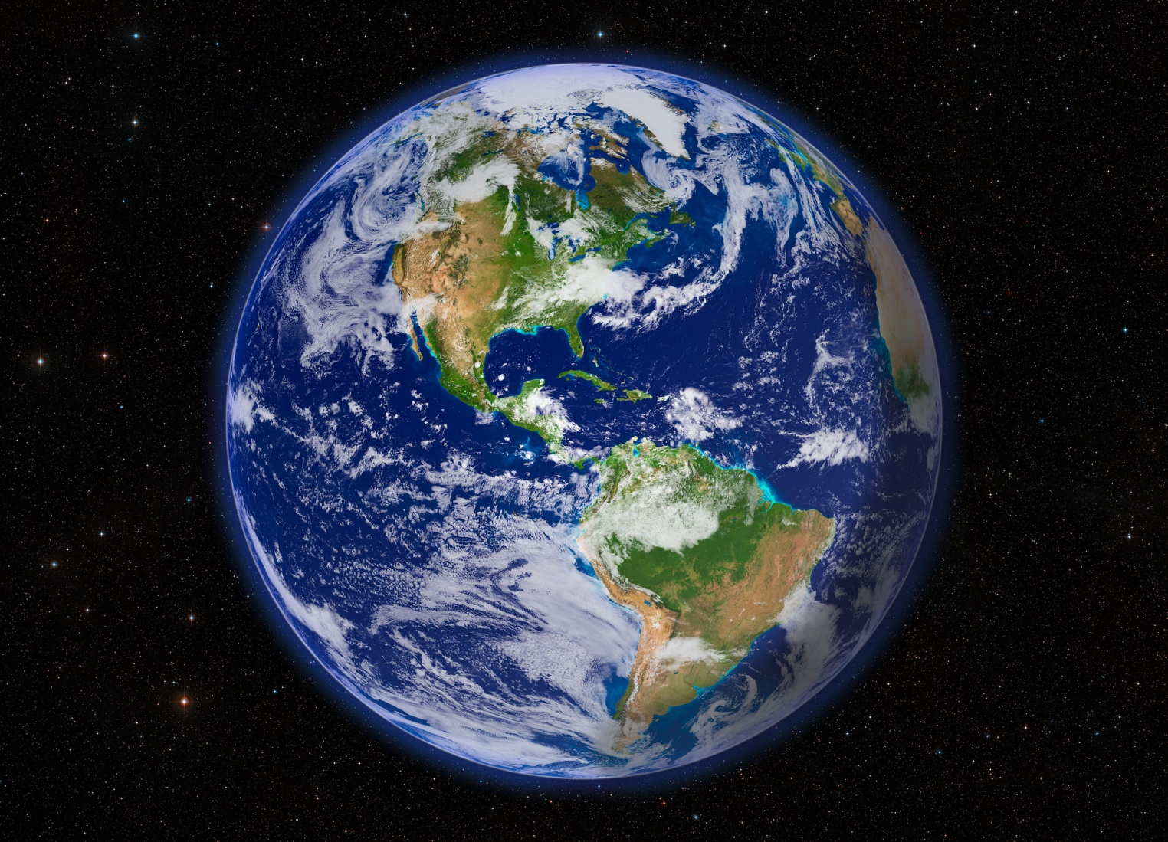
Earth: the Water Planet

Slide 2
There are 2 kinds of water
What are they?

Slide 3
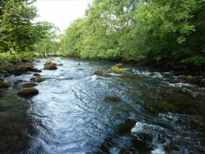

Freshwater

Slide 4
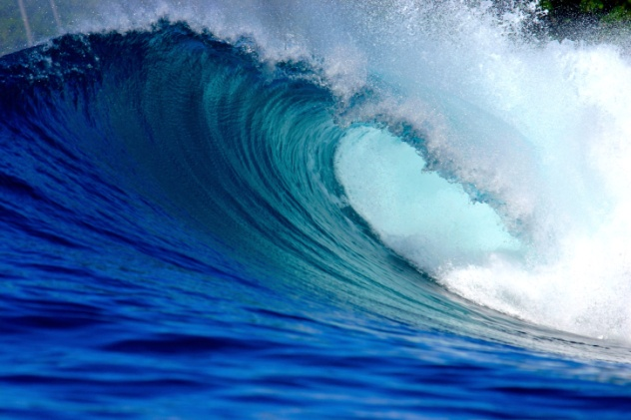
Saltwater

Slide 5
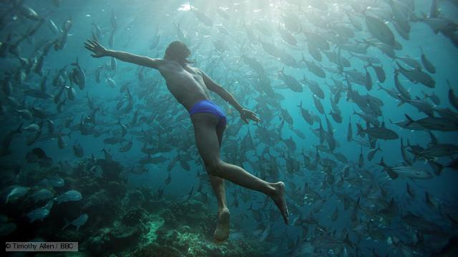
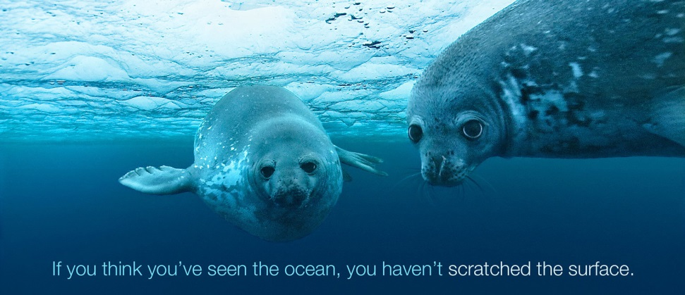
The ocean is full of plants, animals, and food.

Slide 6
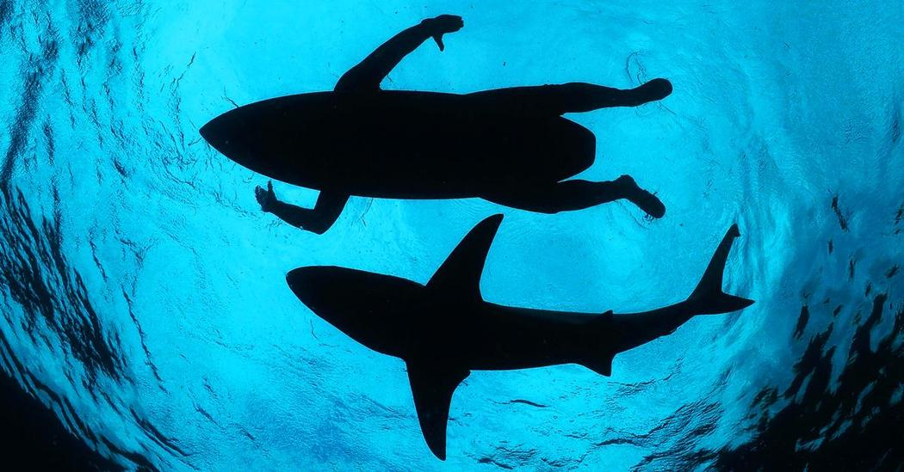
Also a little danger!

Slide 7
Where does the salt come from?
Is it a mystery?

Slide 8
Lets check my new book.
Why don’t penguins feet freeze?
Page 142

Slide 9
Water to Land
How much water is there on the earth
compared to
How much land there is on the earth?

Slide 10
Understanding Percentage
About 71 percent of the Earth's surface is water-covered
About 29 Percent of the earth is covered by land
Spatially, a little more than 70 out of every 100 places on are covered by water

Slide 11
Let’s look closer at the Water World.
How much salt water
Compared to
How much freshwater

Slide 12
the oceans hold about 96.5 percent of all Earth's water. Water also exists in the air as water vapor, in rivers and lakes, in icecaps and glaciers, in the ground as soil moisture and in aquifers, and even in you and your dog

Slide 13
Numbers
To break the numbers down, 96.5% of all the Earth's water is contained within the oceans as salt water, while the remaining 3.5% is freshwater lakes and frozen waterlocked up in glaciers and the polar ice caps. Of that fresh water, almost all of it takes the form of ice: 69% of it, to be exact.

Slide 14
Salt Water vs Freshwater
Lets do an experiment to show this!

Slide 15
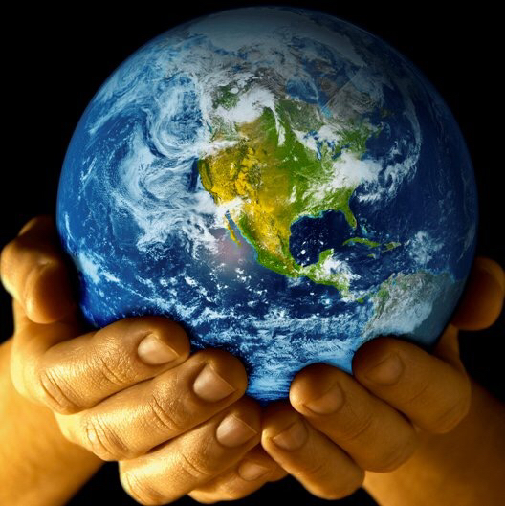
Lets Protect our Precious Freshwater

